Slide 1
AEC

Slide 2
Unit -2

Slide 3
UNIT-I
PN JUNCTION DIODE:
P-N junction diode unde characteristics and Zener Diode Characteristics. Diode applications: Half wave Rectifier, Full wave Rectifier, Bridge Rectifier: construction, Working, Ripple factor, form factor & Efficiency calculations.

Slide 4
BIPOLAR JUNCTION TRANSISTOR:
Definition of Emitter, Base and collector .
Basic operation of BJT and current flow.
I/P and O/P Characteristics CE, CB & CC configurations.
Transistor as a switch.
Switching characteristics (Rise time, Fall time, Delay Time and Storage time),
BJT Biasing Methods & Stabilization.
Fixed Bias,
self Bias and Problems,
Concept of Thermal runway in BJTs.

Slide 5
Bipolar junction Transistor
Contents :
Definition of Emitter, Base and collector .
Basic operation of BJT and current flow.
I/P and O/P Characteristics CE, CB & CC configurations.
Transistor as a switch.
Switching characteristics
(Rise time, Fall time, Delay Time and Storage time),

Slide 6
BJT Biasing Methods & Stabilization.
Fixed Bias,
self Bias and Problems,
Concept of Thermal runway in BJTs.

Slide 7
PN JUNCTION DIODE

Slide 8
Zener diode symbol
A K

Slide 9
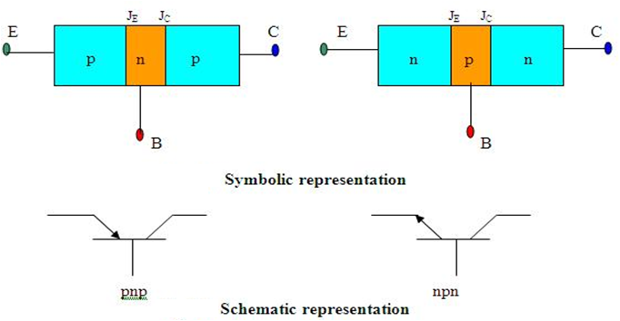

Slide 10
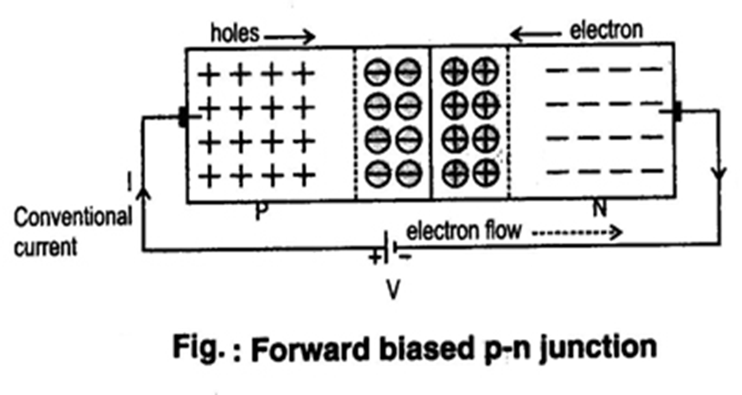
Forward bias

Slide 11
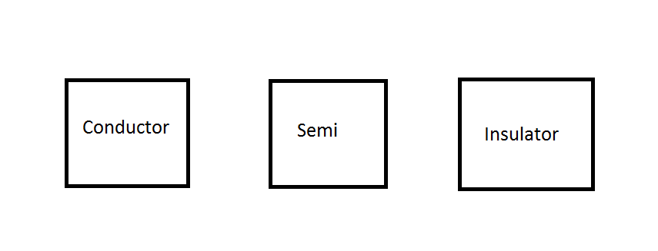

Slide 12
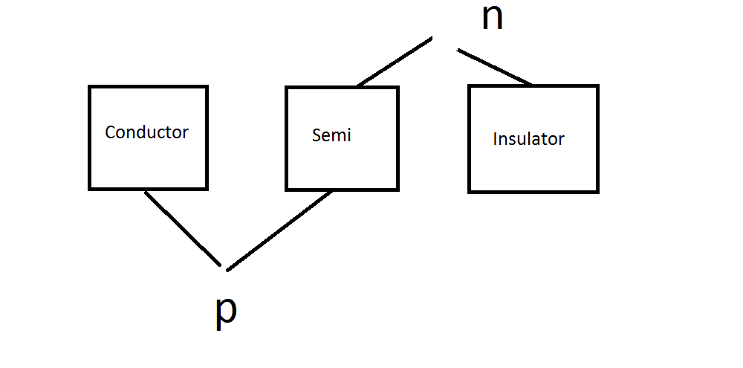

Slide 13
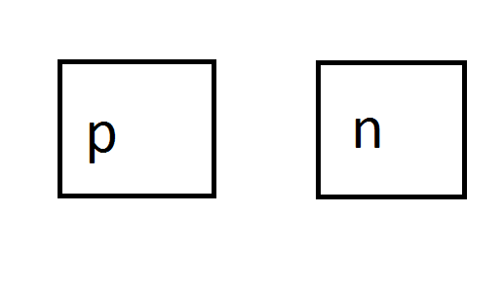

Slide 14
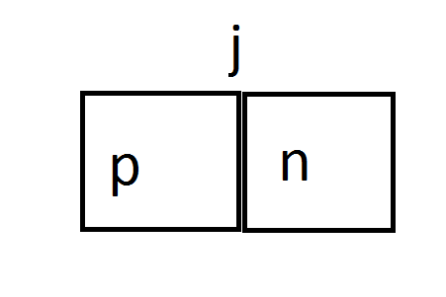

Slide 15
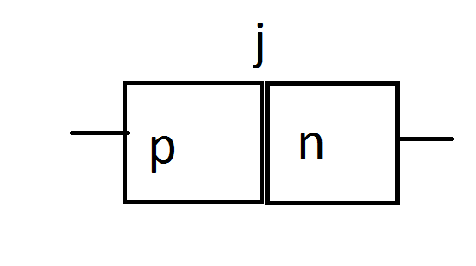

Slide 16
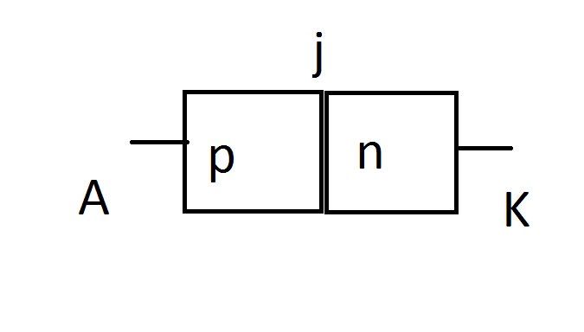

Slide 17
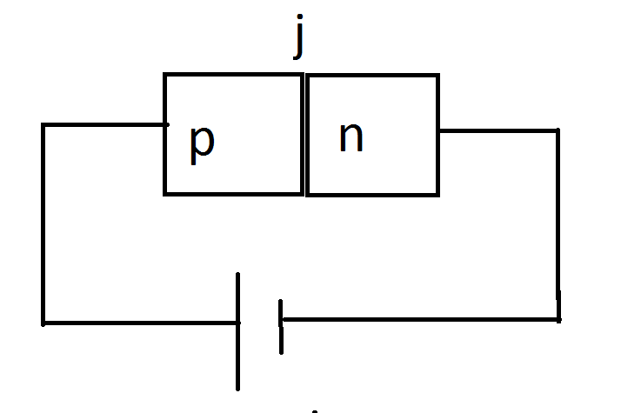

Slide 18
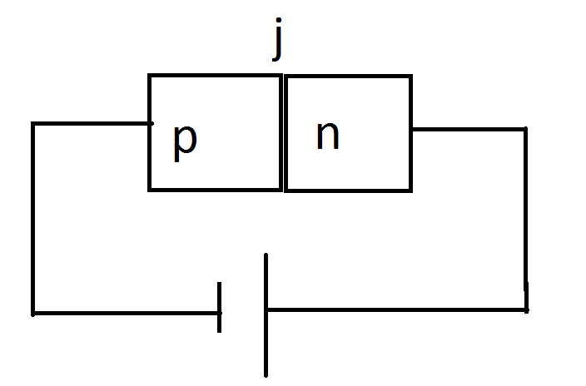

Slide 19
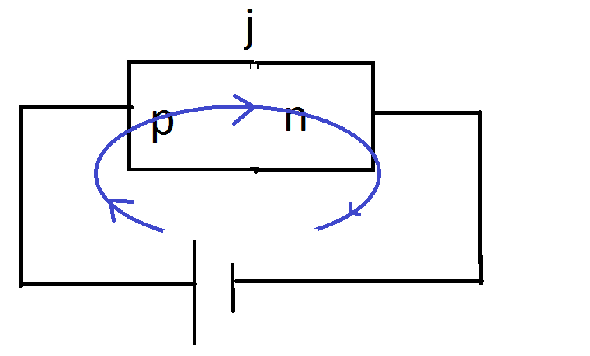

Slide 20
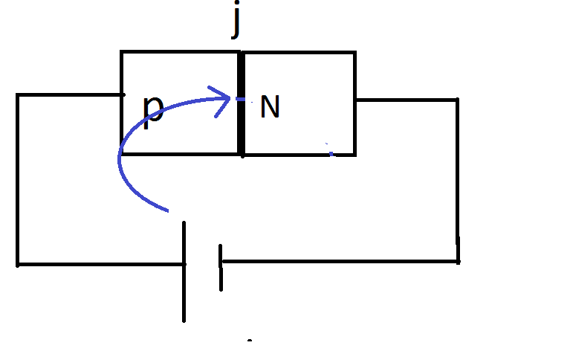

Slide 21
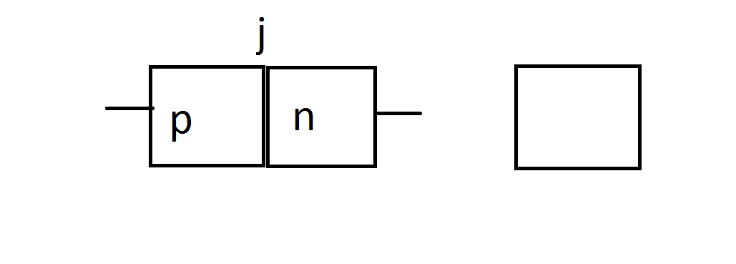

Slide 22
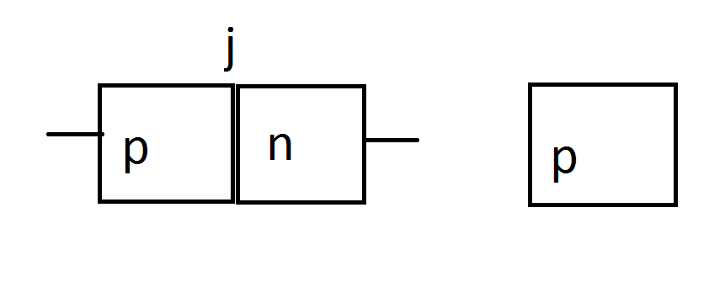

Slide 23
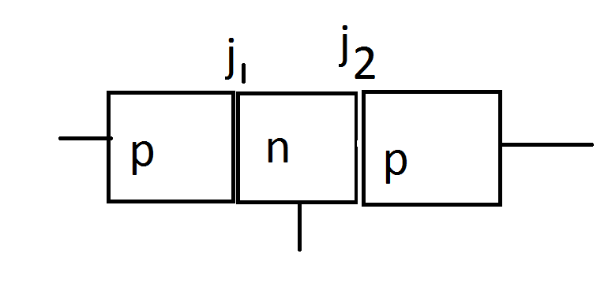

Slide 24
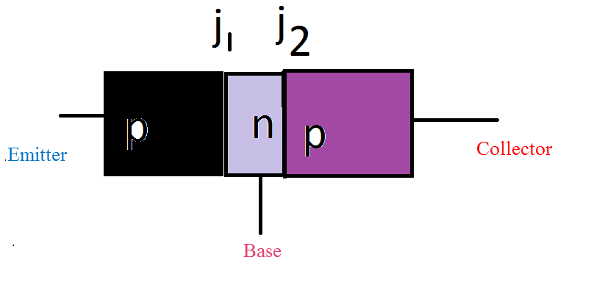
Doping

Slide 25
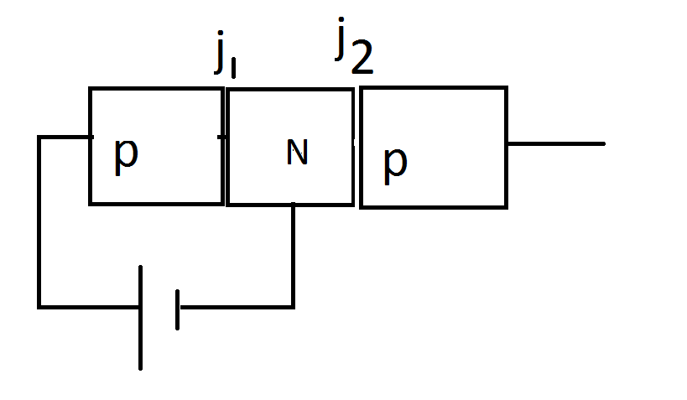

Slide 26
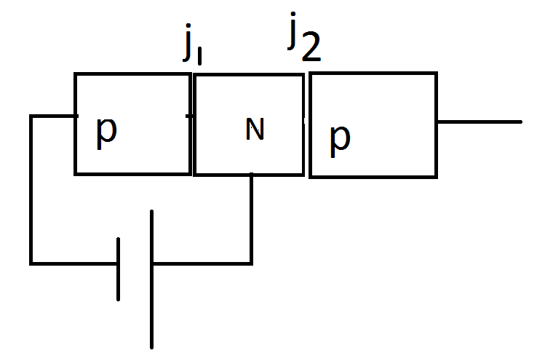

Slide 27
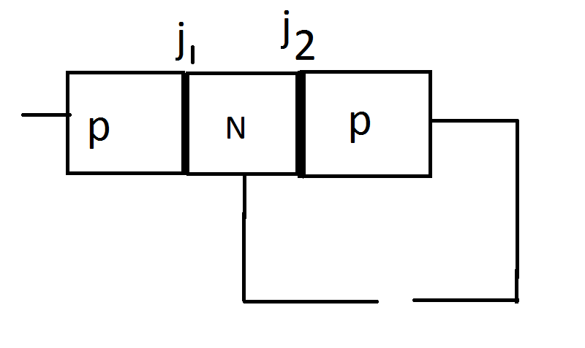

Slide 28
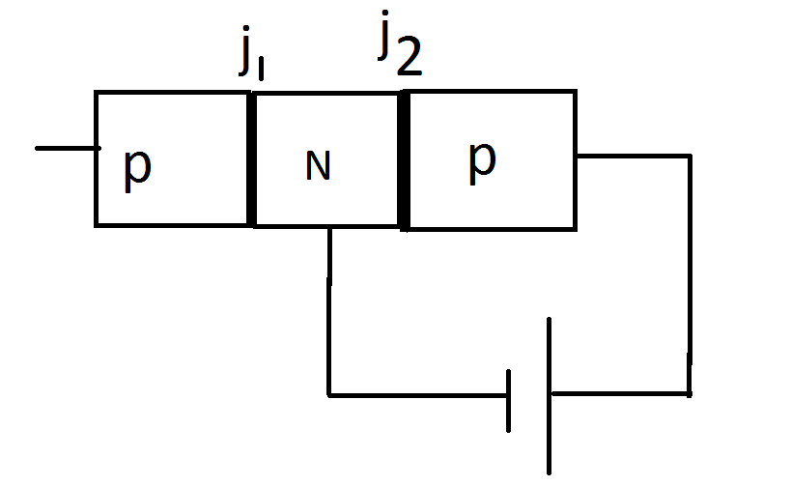

Slide 29
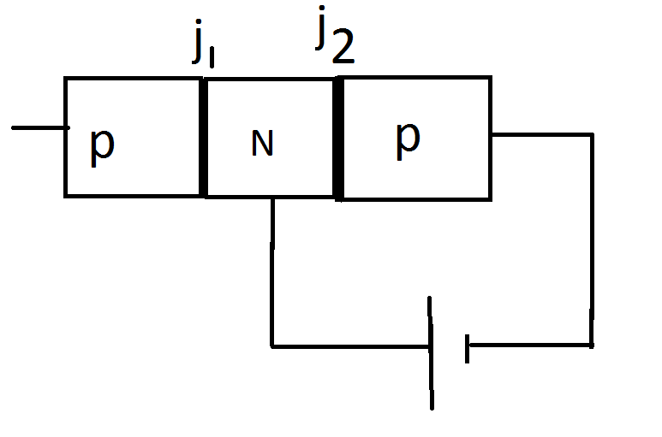

Slide 30
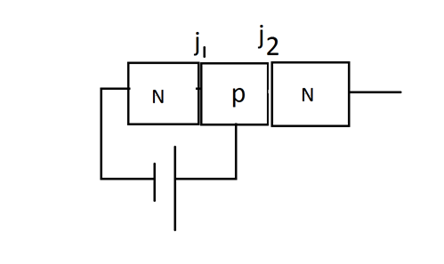

Slide 31
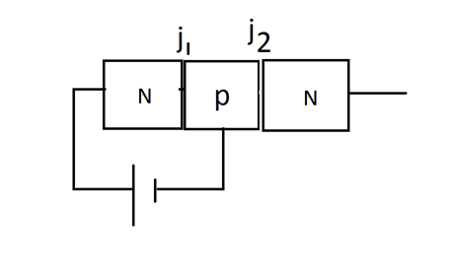

Slide 32
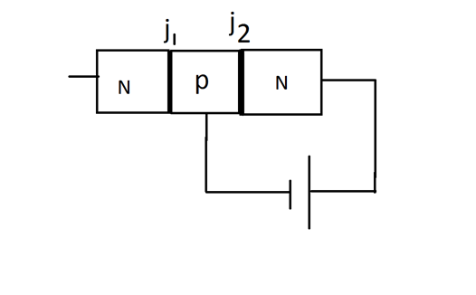

Slide 33
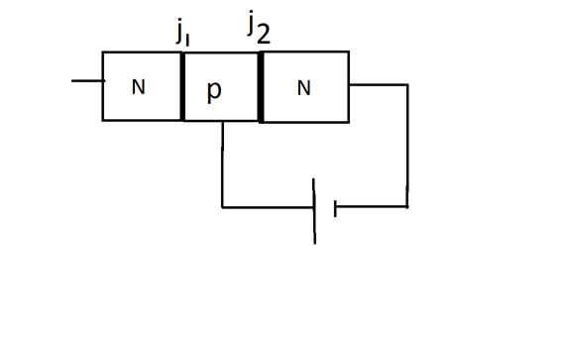

Slide 35
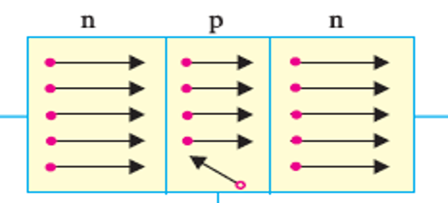


Slide 36
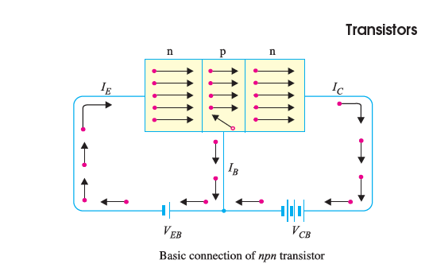

Slide 37
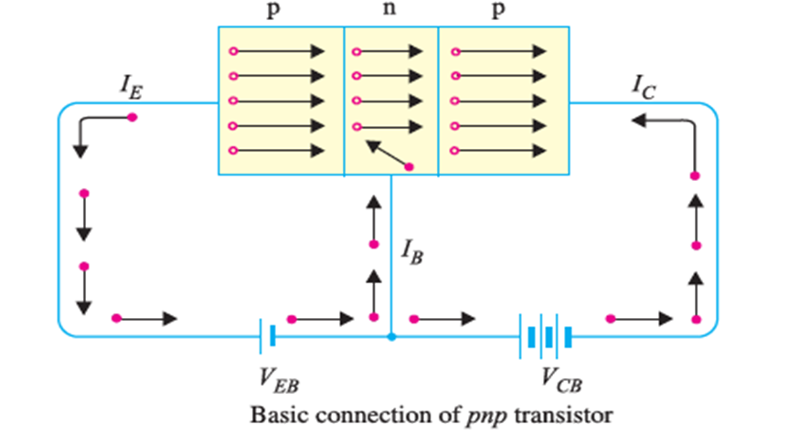

Slide 38
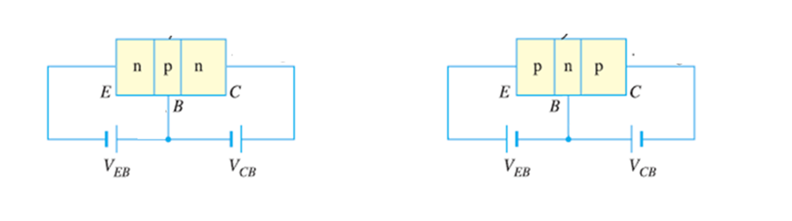

Slide 39
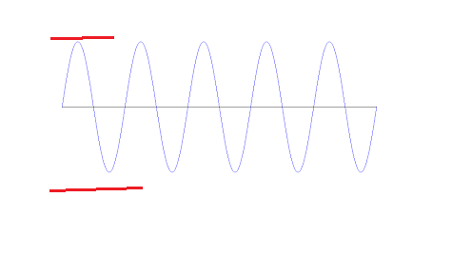
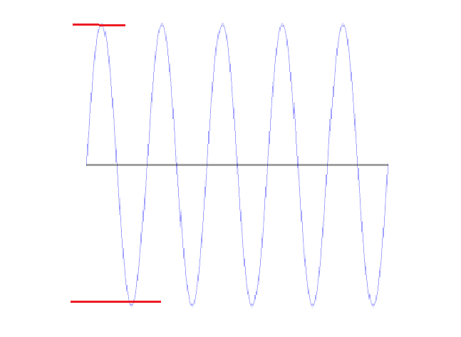

Slide 40
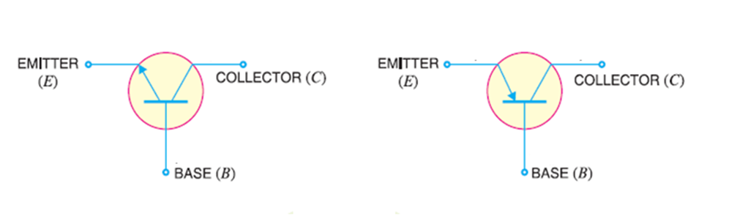

Slide 41
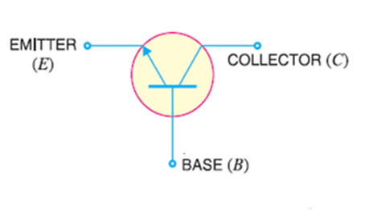

Slide 42
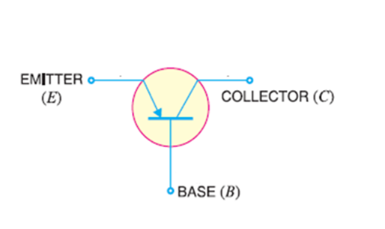

Slide 43
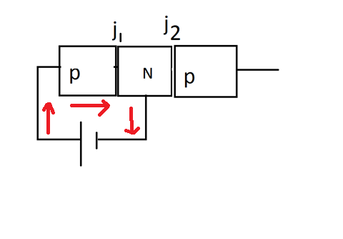

Slide 44

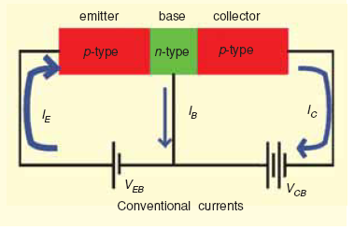

Slide 46
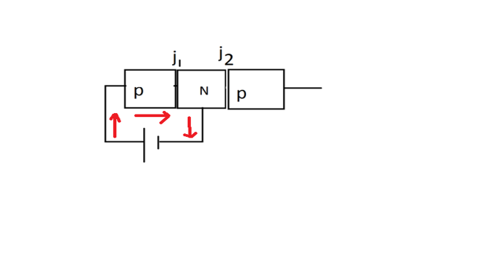

Slide 47
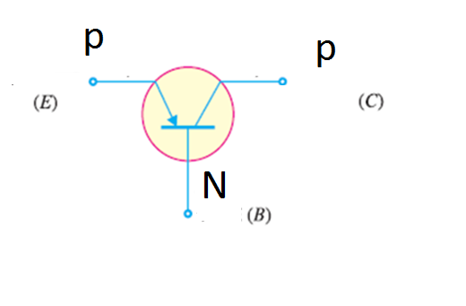

Slide 48
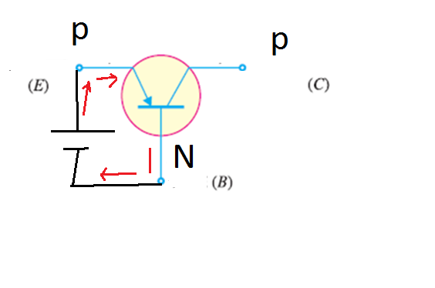

Slide 49
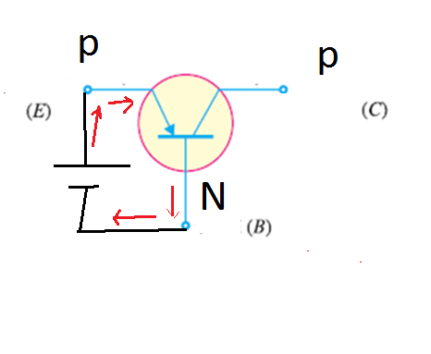

Slide 50
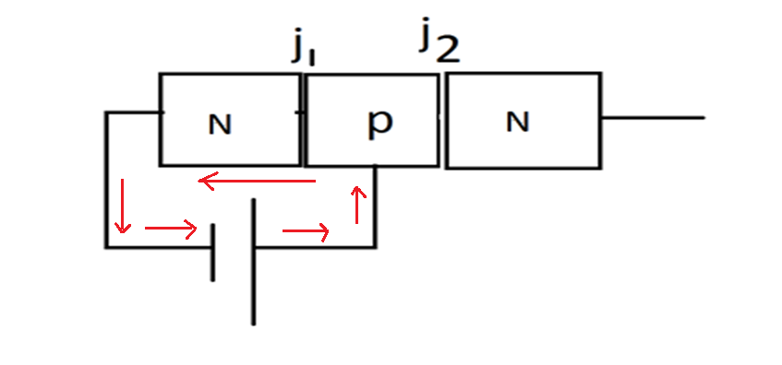

Slide 51
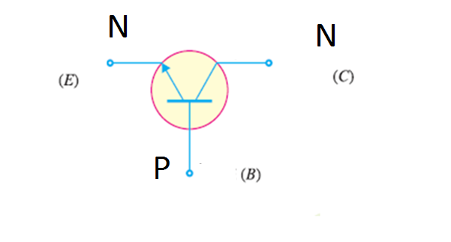

Slide 52
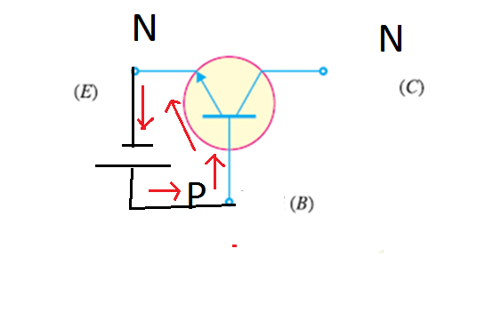

Slide 54
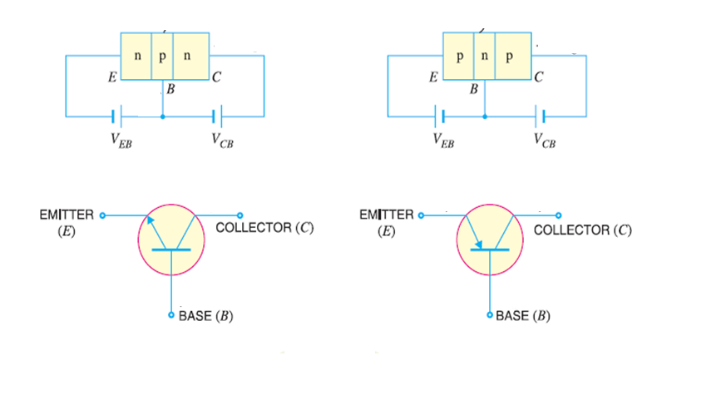

Slide 57
Transistor operating regions.

Slide 58
A transistor can be operated in three different regions as a) Active region b) Saturation region c) Cut-off region

Slide 59
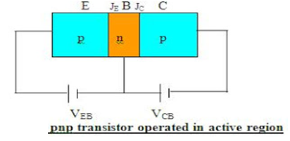

Slide 60
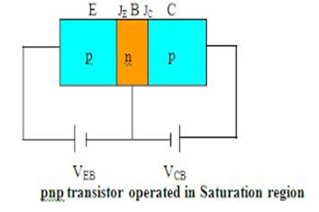

Slide 61
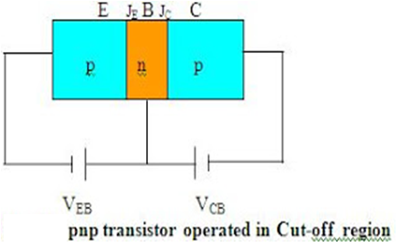

Slide 62
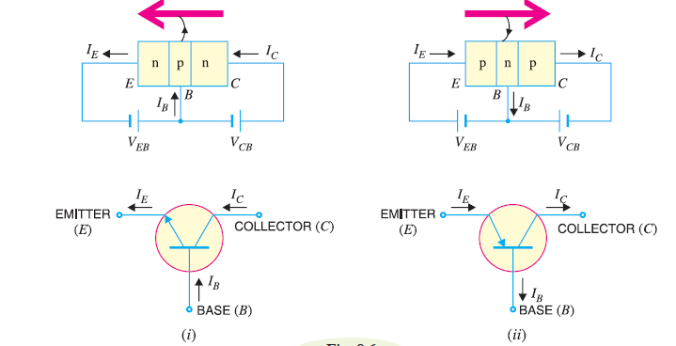
Transistor Voltages and Currents

Slide 63
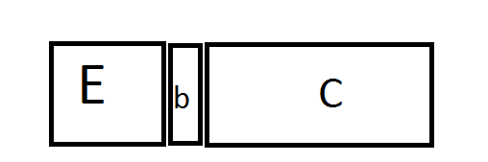
area

Slide 64
Bipolar junction Transistor
A bipolar transistor is a semiconductor device in which electric current flows due to electrons and holes BOTH, simultaneously. Thus both types of charges take part in the conduction of current through it. Hence it is called bipolar transistor.
A bipolar junction transistor (BJT) consists of two PN junctions formed by sandwiching either p-type or n-type semiconductor between a pair of opposite types.

Slide 65
These are two types 1. NPN 2. PNP transistor
The outer layers of the NPN or PNP sandwich are called the emitter and the collector, and the center layer is termed the base.
Two pn junctions are formed with depletion regions and barrier voltages at each junction.

Slide 66
The section on the other side that collects the charges is called the collector . Collector junction is always reverse biased. This section is moderately doped.
Where as emitter is heavily doped so that it can inject a large number of charge carriers into the base.
The base is lightly doped and very thin.
The resistance of emitter diode is small and collector diode is large.
Therefore the transistor transfers the input signal current from a low-resistance circuit to a high-resistance circuit.

Slide 67
The barrier voltages are negative on the p-side and positive on the n-side.
The base-emitter junction is forward, so that charge carriers are emitted into the base.
The collector-base junction is reverse-biased, and its depletion region penetrates deep into the base.

Slide 69
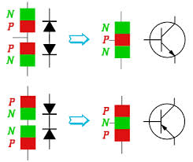

Slide 70
A transistor (PNP or NPN) has three sections of doped semiconductors.
It consists of 3 terminals
1.Emitter 2. Base 3. Collector
Section on one side that supplies charge carriers (electrons of holes) is called emitter. Which is heavily doped .
The middle section which form two pn-junctions between the emitter and collector is called the base.

Slide 73


Slide 76


Slide 77
2. Transistor Voltages and Currents

